Slide 1
C.O.D.E Session
Introduction to Spring
By Aaron Korver

Slide 2
Spring is a lightweight inversion of control container that enables you to develop complex application with POJOs.
What is Spring?
Notes:
POJO = Plain old Java Objects

Slide 3
Inversion of Control
Also known as the “Hollywood Principle” (Don’t call me, I’ll call you)
IoC creates the difference between a library and a framework
Notes:
One important characteristic of a framework is that the methods defined by the user to tailor the framework will often be called from within the framework itself, rather than from the user's application code. The framework often plays the role of the main program in coordinating and sequencing application activity. This inversion of control gives frameworks the power to serve as extensible skeletons. The methods supplied by the user tailor the generic algorithms defined in the framework for a particular application.
Inversion of Control is a key part of what makes a framework different to a library. A library is essentially a set of functions that you can call, these days usually organized into classes. Each call does some work and returns control to the client.
A framework embodies some abstract design, with more behavior built in. In order to use it you need to insert your behavior into various places in the framework either by subclassing or by plugging in your own classes. The framework's code then calls your code at these points.

Slide 4
Dependency Injection
A specific type of IoC with two “flavors”
Constructor Injection
Setter Injection

Slide 5
Code without Spring
Class AgentService
{ private AgentDAO dao;
private EmailService email;
public AgentService(AgentDAO daoIn, EmailService emailServiceIn)
{ dao = daoIn; email=emailServiceIn;}
}
Using the service…..
AgentDAO daoIn = createDAO();
EmailService emailServiceIn = createEmailService();
AgentService agentService = new AgentService(daoIn, emailServiceIn);
The DAO needs a Datasource, and the EmailService needs a SMTP Server, SMTP port, etc etc….

Slide 6
Code with Spring
Assume same AgentService definition.
AgentService service = (AgentService)applicationContext.
getBean(“agentService”);
Yup, that’s it! The magic lies within the Spring Container

Slide 7
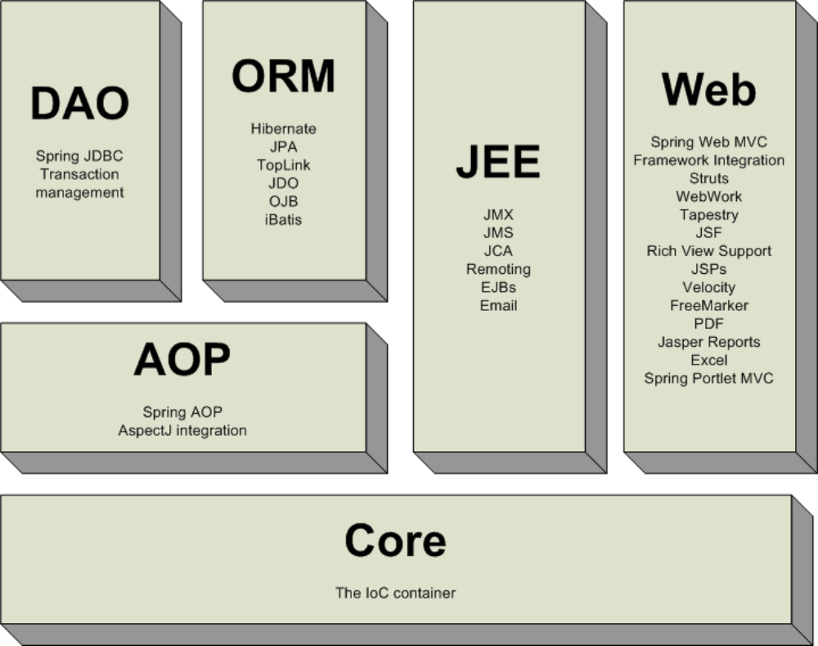

Slide 8
Spring’s Goals
Spring's main aim is to make J2EE easier to use and promote good programming practice.
Spring does not reinvent the wheel.
Spring does aim to make existing technologies easier to use.
Writing testable code is critical and the container should help - not interfere - with this objective.
Spring should be a pleasure to use

Slide 9
Spring Bean Container
Bean Factory
  Provides basic support for dependency injection
  Configuration and lifecycle management
Application Context
  Builds on Bean Factory and adds services for:
    Message lookup, supporting i18n
    Loading of generic resources
    Publishing events
Notes:
I18n = internationalization

Slide 10
Back to our example…
The AgentService (remember him?) needed a few things to work.
A J2EE DataSource
A DAO that uses the DataSource

Slide 11
Bean Definition File spring.xml
<?xml version=“1.0” encoding=“UTF-8”?>
<!DOCTYPE beans PUBLIC “-//SPRING/DTD BEAN//EN”
“http://www.springframework.org/dtd/spring-beans.dtd”>
<beans>
<bean id="myDataSource” class=”org.spring.BasicDataSource">
<property name="driverClassName" value="com.jdbc.Driver"/>
<property name="url” value="jdbc://serverName:33/DBName”/>
<property name="username" value="someone" />
</bean>
<bean id=”agentDAO” class=”com.fbfs.AgentDAO">
<property name="dataSource" ref="myDataSource" />
</bean>
<bean id=”agentService” class=”com.fbfs.AgentService">
<constructor-arg ref=”agentDAO" />
<constructor-arg ref=“myEmailService”/>
</bean>
</beans>
Notes:
Note it can be any name for the xml file. I simply chose to call it “spring.xml”

Slide 12
Creating a Spring Container
ApplicationContext context = new ClassPathXmlApplicationContext(new String[] {“spring.xml”});
Then we simply get the bean from the container.
AgentService service = (AgentService)context.
getBean(“agentService”);

Slide 13
Switch the DataSource
<bean id="myDataSource” class="org.springframework.jndi.JndiObjectFactoryBean>
<property name="jndiName”value="jdbc/myDataSource"/>
</bean>

Slide 14
JDBC Typical Work
Define connection parameters
Open the connection
Specify the statement
Prepare and execute the statement
Set up the loop to iterate through the results (if any)
Do the work for each iteration
Process any exception
Handle transactions
Close the connection
Notes:
Only the italicized lines need to be coded by the developer

Slide 15
Spring + JDBC = :-)
AgentDAO……
public List getAgentNames()
{
JdbcTemplate template = new JdbcTemplate(dataSource);
List names = template.query("SELECT USER.NAME FROM USER",
new RowMapper() {
public Object mapRow(ResultSet rs, int rowNum) throws SQLException{
return rs.getString(1);
}
});
return names;
}
Notes:
Note that dataSource is the same one that we configured in the spring.xml file

Slide 16
Benefits from using this
You’ll never ever ever ever ever need to write a finally block again in JDBC. :-D
The risk of Connection leaks becomes very low.
Less code overall is written, less code means less of a chance for defects.

